Slide 1




BỘ GIÁO DỤC VÀ ĐÀO TẠO TRƯỜNG ĐẠI HỌC SƯ PHẠM KỸ THUẬT TP. HỒ CHÍ MINH KHOA CÔNG NGHỆ THÔNG TIN
SUBJECTS : SPECIALIZED ESSAYS
TOPIC: LEARN EMBEDDING TECHNIQUES IN NATURAL LANGUAGE PROCESSING
Teacher: ThS. Quách Đình Hoàng
Members group:
Cao Anh Văn 19133067
Trần Thành Quang 19133047

Slide 2
Content:
Introduction to natural language processing
Word embedding
Text summary
Build Model
Measure for summary text
Demo Application
Summary
Reference

Slide 3
01
NATURAL LANGUAGE PROCESSING

Slide 4

NATURAL LANGUAGE PROCESSING
What is the natural language processing?
Natural language processing (NLP) is a branch of artificial intelligence that helps computers understand, interpret, and manipulate human language. NLP aims to bridge the communication gap between humans and computers.

Slide 5
NATURAL LANGUAGE PROCESSING
Applications of NLP
Text classification
Information extraction
Text summarization
Question answering

Slide 6
02
WORD EMBEDDING

Slide 7
WORD EMBEDDING
What is the word embedding ?
Computer or Natural language processing (NLP) models do not work with plain text → numerical representation was required.
Word embedding is a class of techniques where word is represented as a real value vectors.
Word embedding can be represented in smaller dimension compared to sparse representation like one-hot encoding.
It can be broadly categorized in two parts: frequency-based embeddings and prediction-based embeddings.

Slide 8
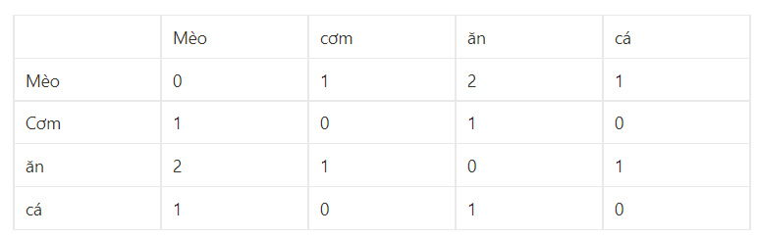
WORD EMBEDDING
Frequency-based word embedding
Counting the number of co-occurrence of a word
example for sentence : “Mèo ăn cơm” ,”Mèo ăn cá”
TF-IDF : reduce the weightage of frequent words

Slide 9
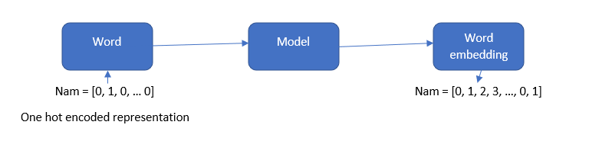
WORD EMBEDDING
Prediction based word embedding
It is a method to learn dense representation of word from a very high dimensional representation.
It is a modular representation, where a sparse vector is fed to generate a dense representation. Typical is Word2Vec.

Slide 10
WORD EMBEDDING
Word2Vec
It was proposed by Tomas Mikolov and his team at Google in 2013.
It is a neural network trained to learn the contextual relationship.
It places contextually similar word near to each other.
Two variants of the model was proposed:
Continuous bag of words model (CBOW).
Skip-gram model.

Slide 11
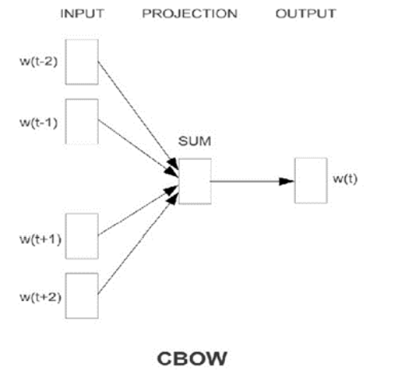
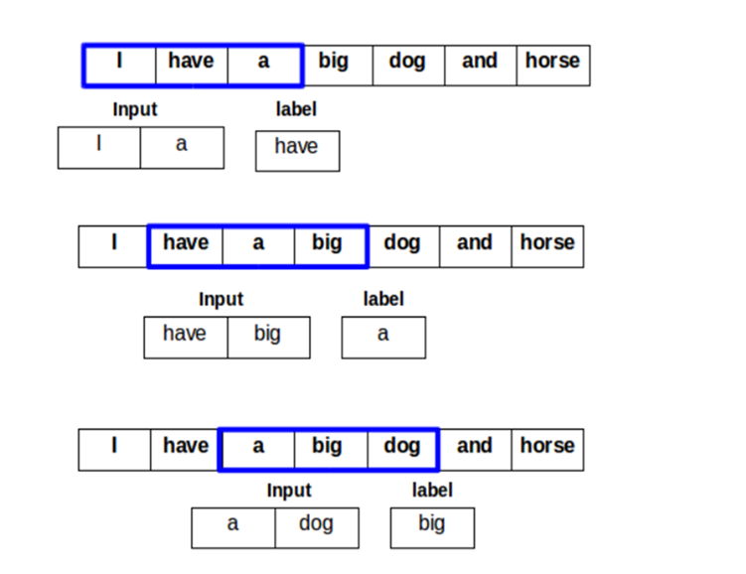
WORD EMBEDDING
Word2Vec - CBOW
Goal: Predict the center word, given the context words.
One hot encoded of the context words Wt-2, … Wt+2 is input to the model.

Slide 12
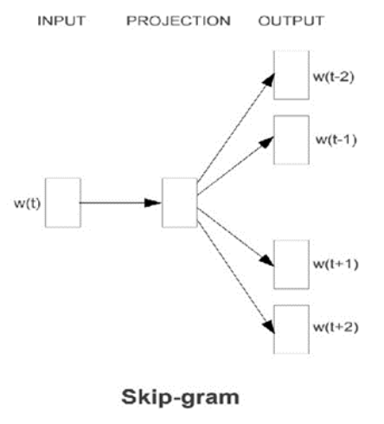
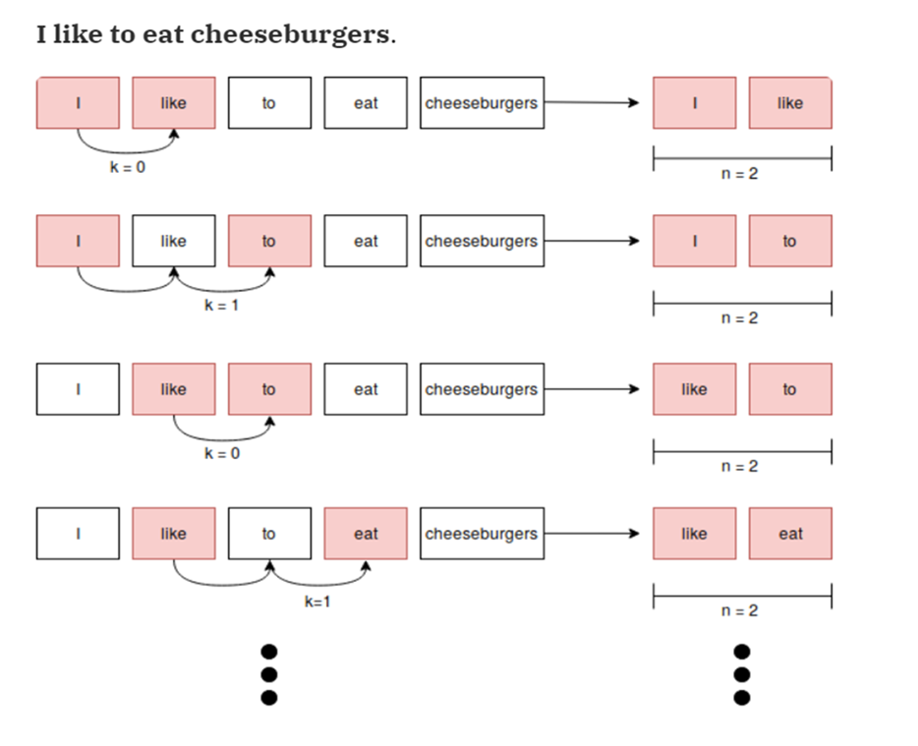
WORD EMBEDDING
Word2Vec - Skip-gram
Goal: Predict the context word Wt-2, … Wt+2 given the word Wt.

Slide 13
03
SUMMARY TEXT

Slide 14
SUMMARY TEXT
What is the summary text?
The process of extracting the most important information of a document
Short, concise, full of information
Grammatical and spelling correctness
The abstract should retain the important information of the entire main text

Slide 15
SUMMARY TEXT
The importance of text summaries
Make reading easier
Save more reading time.
Easier to remember information.
Increase work efficiency

Slide 16
04
BUILDING MODEL FOR SUMMARY TEXT

Slide 17
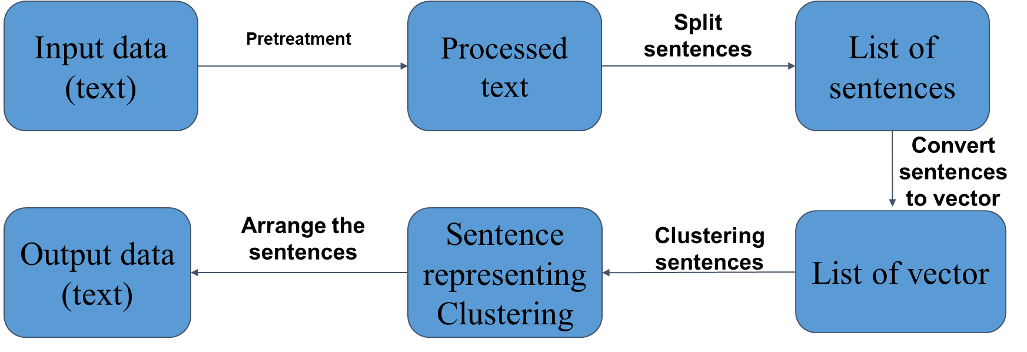
BUILDING MODEL FOR SUMMARY TEXT

Slide 18

BUILDING MODEL FOR SUMMARY TEXT
Pretreatment
Our input text may contain extra characters, extra punctuation, extra spaces, acronyms, capitalization.
Convert all to lowercase and Remove extra spaces.

Slide 19
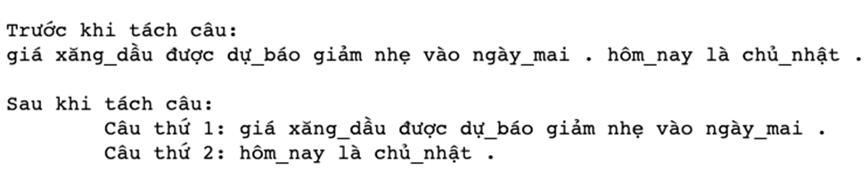
BUILDING MODEL FOR SUMMARY TEXT
Split sentences in the text
we will split a processed summary text into a list of sentences in it.

Slide 20
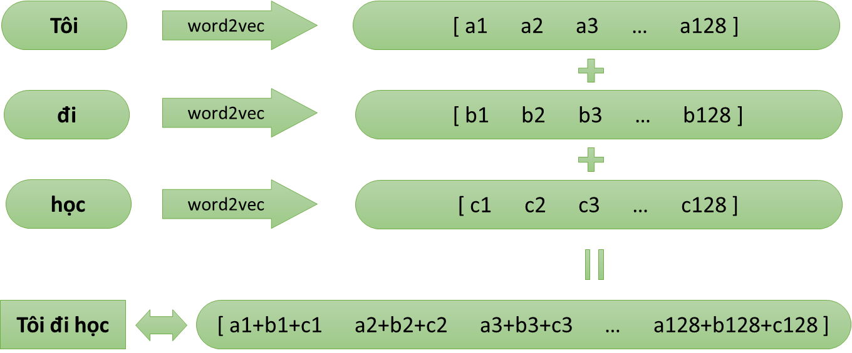
BUILDING MODEL FOR SUMMARY TEXT
Convert sentences to vector
example for a sentence : “Tôi đi học”

Slide 21
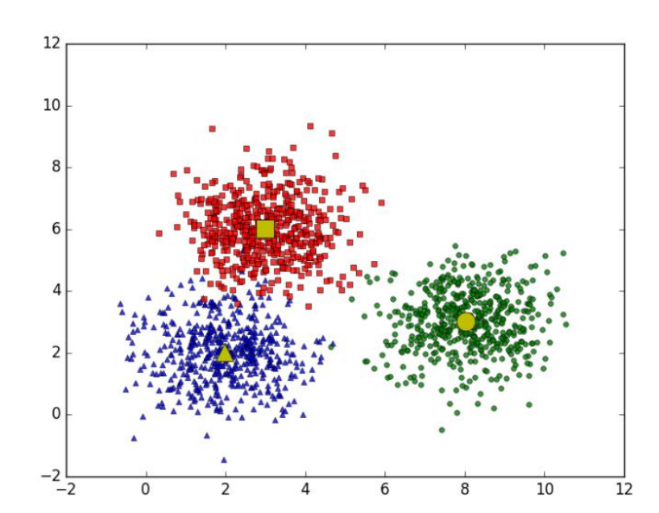
BUILDING MODEL FOR SUMMARY TEXT
Clustering sentences
Group similar sentences into a group (number of groups = number of sentences of summary text).

Slide 22
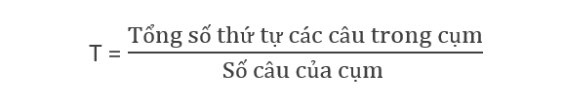
BUILDING MODEL FOR SUMMARY TEXT
Sort the sentences that represent output
For each cluster determine a sentence with the most generality: the sentence closest to the cluster center.
Calculate the average order of the cluster:
Arrange the sentences representing the cluster in the correct order of the average of the cluster containing that sentence => Summary text

Slide 23
05
MEASURE FOR SUMMARY TEXT

Slide 24
MEASURE FOR SUMMARY TEXT
4 criteria to evaluate a summary
Comprehensive
Concise
Coherent
Not hallucinate

Slide 25
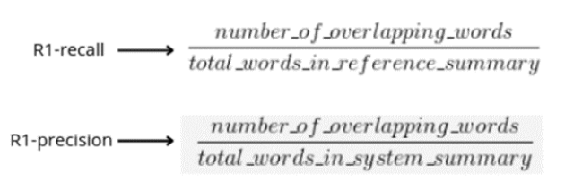
MEASURE FOR SUMMARY TEXT
Rouge
This is an index based on the calculation of syntactic duplication between versions abstract and original text.

Slide 26
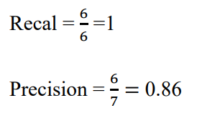
MEASURE FOR SUMMARY TEXT
Rouge
Example:
Original sentence: The cat was found under the bed.
Reference sentence: The cat was under the bed.

Slide 27
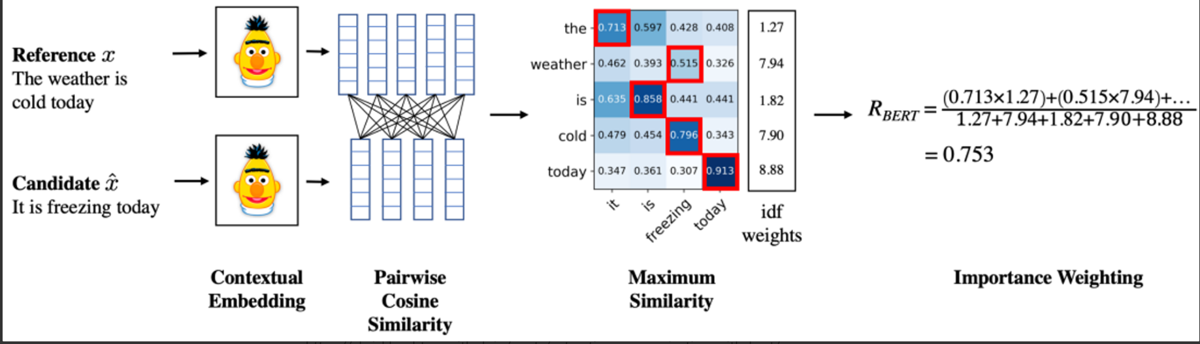
MEASURE FOR SUMMARY TEXT
Bert score
BERTScore focuses on computing semantic similarity between tokens of reference and hypothesis.
Instead of exact matches, bert score calculates the similarity using contextual embeddings.

Slide 28
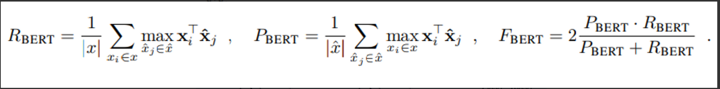
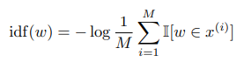
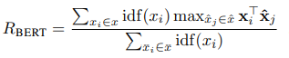
MEASURE FOR SUMMARY TEXT
Bert score
Formula to calculate R, P, F
In the formula idf:
II is indicator function.

Slide 29
06
DEMO APPLICATION

Slide 30
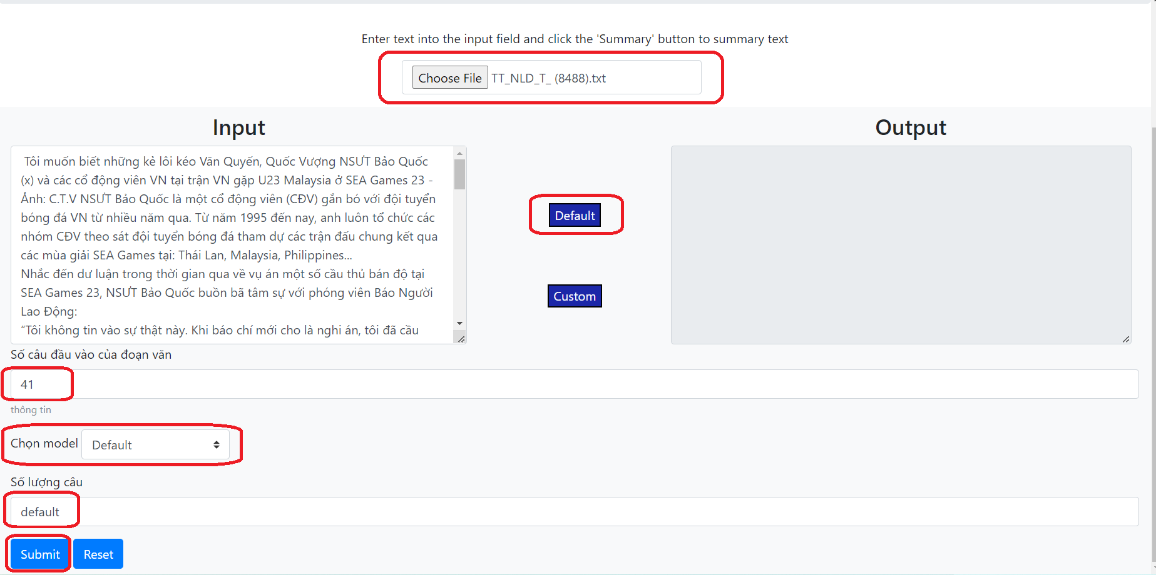
DEMO APPLICATION
Web page - Default

Slide 31
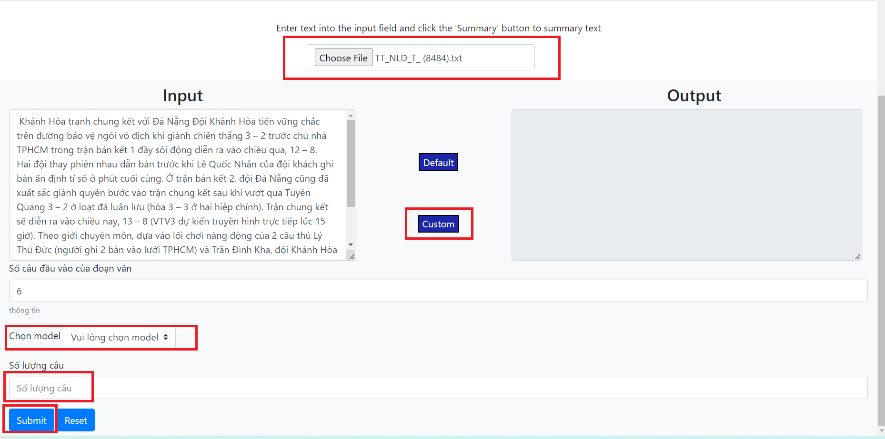
DEMO APPLICATION
Web page - Custom

Slide 32
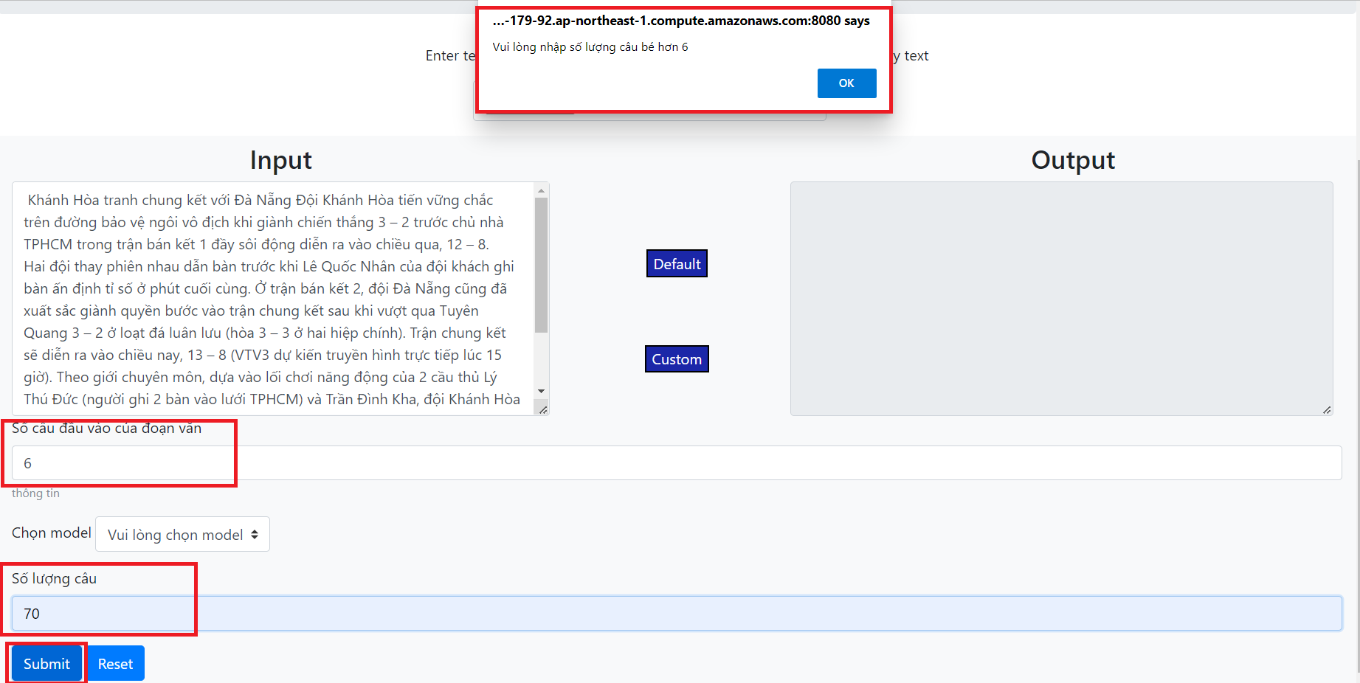
DEMO APPLICATION
Web page - Error parameters

Slide 33
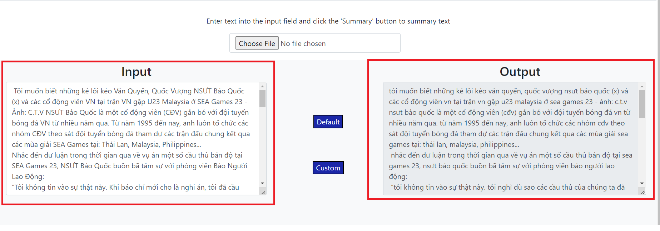
DEMO APPLICATION
Web page - result

Slide 34
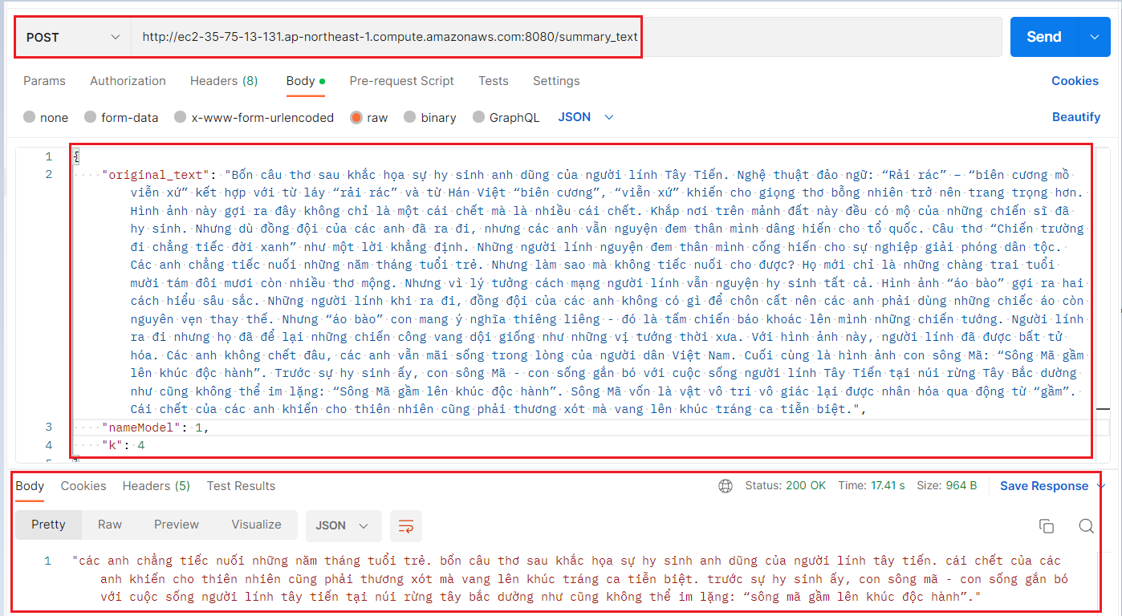
DEMO APPLICATION
API

Slide 35
07
SUMMARY

Slide 36
SUMMARY
Result
- Find out the knowledge about natural language processing, word embedding.
- Apply the above knowledge to the text summarization problem using - word2vec, K-Means algorithm and Bert score measure.
- Build a web demo application for text summarization using python (flask) + deploy the application to AWS.

Slide 37
SUMMARY
Difficulties and development directions
Difficulties: Documentation of bert score.
Development direction:
More complex algorithm.
Better handling method: doc2vec.

Slide 38
08
REFERENCE

Slide 39
REFERENCE
1. Word2vec training data: Duyvuleo, VNTC, 01/01/2016, latest accessed 12/12/2022, https://github.com/duyvuleo/VNTC
2. Linhnvc, vietnamese-text-summarization, 01/01/2019, latest accessed 12/12/2022
3. K-Means Clustering: machinelearningcoban, Lesson 4: K-means Clustering, 1/1/2017, last accessed 12/17/2022, https://machinelearningcoban.com/2017/01/01/kmeans/
4. etc

Slide 40


